Slide 1

Carbon Footprints &
Sustainable Solutions:
Inspiring NC Youth to Address Global Warming
Dana Haine
UNC-CH Institute for the Environment

Slide 2
The Environmental
Resource Program
Serves as the outreach and public service arm of UNC’s Institute for the Environment.
Promotes environmental stewardship and public health through education, research, and community service.
Links the environmental resources of UNC to the people of North Carolina.

Slide 3
Session Agenda
Welcome and Introductions
Activity 1: What is your Carbon Footprint?
Activity 2: What is Sustainability?
Activity 3: Hidden Energy:
Secondary Carbon Footprints

Slide 4

List the various ways you depend on energy in a typical day.

Slide 5


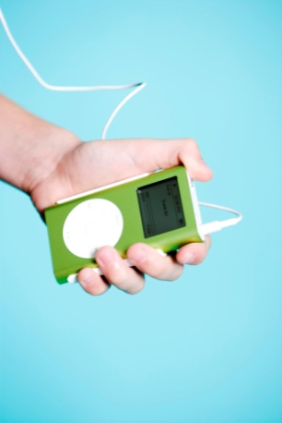
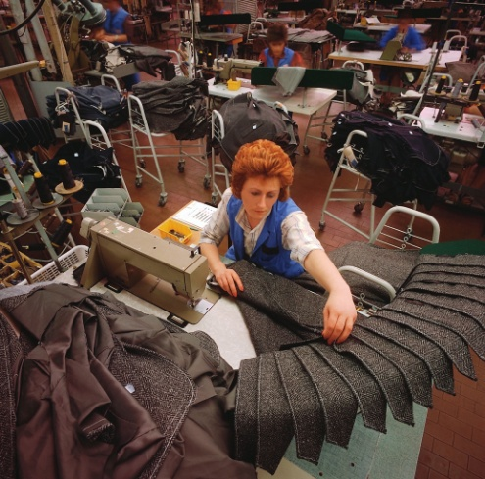


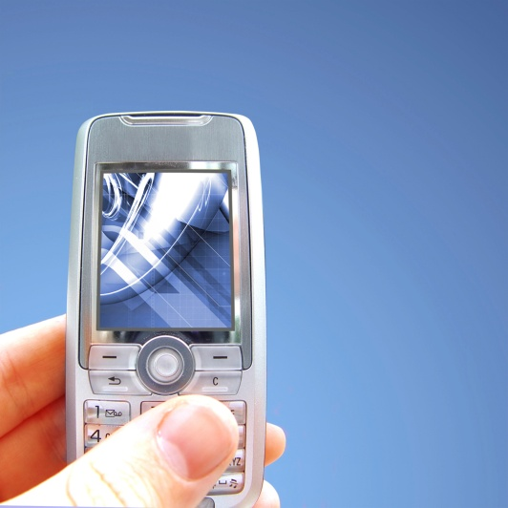
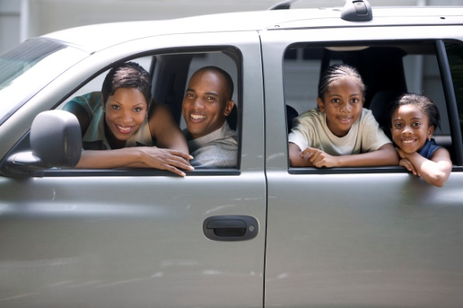
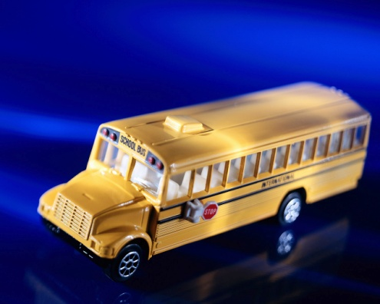
List the various ways you depend on energy in a typical day.

Slide 6
American Energy Consumption
Americans consume 40% more energy per person compared to the world average.
World
5.0 TOE/person
United States
8.35 TOE/person
Total primary energy supply TOE (tons of oil equivalent) per person (2000).
lEA, Energy Balances of OECD Countries 1999-2000 (lEA, Paris, 2001).

Slide 7
Where does our energy come from?

Slide 8
Where does our energy come from?
Fossil fuels (Natural Gas, Oil, Coal)
Nuclear Power
Hydropower
Wind Power
Solar Power
Landfill Methane
Renewable Energy

Slide 9
What is the connection between Energy and Carbon Dioxide?

Slide 10
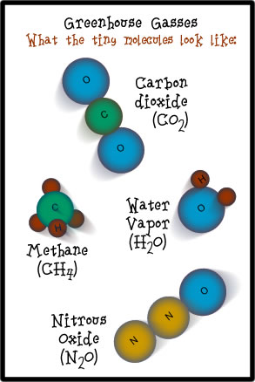

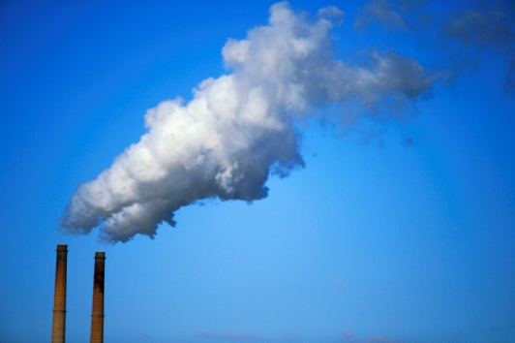
What is the connection between Energy and Carbon Dioxide?
=
Energy Use
CO₂ makes up approximately
85 percent of total greenhouse
gas (GHG) emissions.

Slide 11
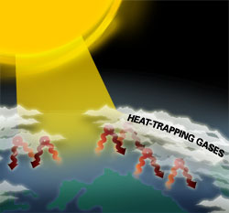
What is the connection between Carbon Dioxide and Global Warming?
http://www.fightglobalwarming.com/page.cfm?tagID=273

Slide 12
What human activity produces the most greenhouse gases (CO₂)?

Slide 13
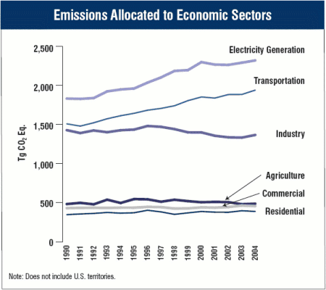
What human activity produces the most greenhouse gases (CO₂)?
Electricity Generation
Transportation
Industry
Agricultural
Commercial
Residential
Inventory of U.S. Greenhouse Gas Emissions and Sinks: 1990-2004, EPA.

Slide 14
Electricity Generation:
Where does your electricity come from?
EPA’s Power Profiler

Slide 15
The average person generates 94lbs of CO₂ per day.

Slide 16

Activity 1:
What is your Carbon Footprint?
Go to EPA’s Carbon Footprint Calculator
http://www.epa.gov/climatechange/emissions/ind_calculator.html
Please complete the companion Carbon Footprint worksheet (provided) as you calculate your carbon footprint.

Slide 17

Carbon Reduction Solutions
What can YOU do to reduce your carbon footprint?

Slide 18
Carbon Reduction Solutions
Reducing CO₂ emissions benefits:
  The environment
  The economy
  Society
Practices that benefit all three of these
are said to be sustainable.

Slide 19

Dr. Seuss's The Lorax can be used to help students discover the concept of sustainability.

Slide 20
Sustainability
Common use of the term “sustainability" began with the 1987 publication of the World Commission on Environment and Development report, Our Common Future.
Notes:
Define Sustainability and its 3 components (environment, economy, society). May have to explore the meaning of “needs.”

Slide 21

Sustainable Development
“Development that meets the needs of the present without compromising the ability of future generations to meet their own needs.”
  Our Common Future

Slide 22
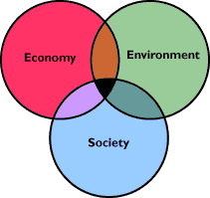
Three Parts of Sustainability
Healthy Environment
Healthy Economy
Healthy Society
From: http://www.sustainablemeasures.com

Slide 23
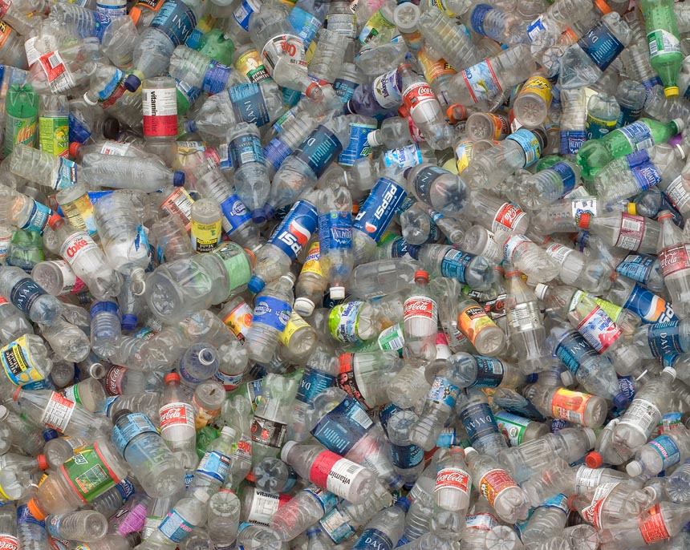
Is this sustainable?
http://www.chrisjordan.com/

Slide 24
Is it Sustainable?
Can this activity be done without causing damage in these three areas?
Can this activity be done so that people in the future will have the same opportunities to do this activity?
Notes:
Emphasize that impacts can be +,-, or neutral.

Slide 25

Is it Sustainable?
  Driving
  Think-Pair-Share Activity #1
Notes:
Assess the sustainability of one activity as a class.

Slide 26
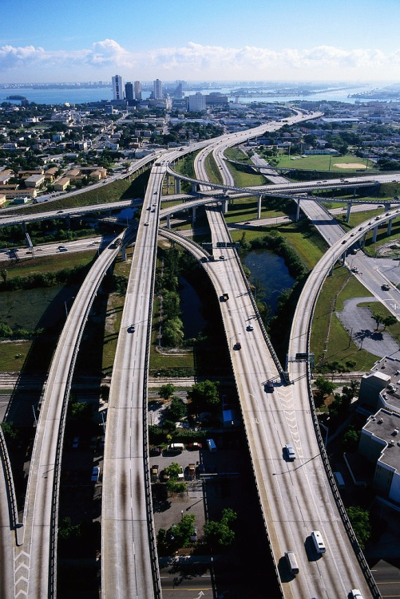
Driving
Environment
Economy
Society
How does driving impact the:
Notes:
Emphasize that impacts can be +,-, or neutral.

Slide 27
Is it Sustainable?
  Choose one:
  Individual Activities
  School Activities
  Government Actions
  Business Products/Services
  Think-Pair-Share Activity #2
Notes:
Assess the sustainability of one activity as a class.

Slide 28
Individual activities -Owning/using a cell phone -Driving above the speed limit -Eating at McDonald’s for breakfast -Drinking bottled water at lunch -Shopping at the Saturday farmer’s market | School activities - Hosting a Friday night high school football game - Going on a class field trip to the zoo - Buying recycled paper for copiers - Selling soft drinks in vending machines - Allowing students to drive off-campus for lunch
Government actions Offering curbside trash pick-up Raising the fee to ride public transportation Building an energy efficient courthouse Building sidewalks to the local high school from neighboring suburbs | Business products/services Making computers Producing organic cotton T-shirts Building a 5,000 sq ft. house in the suburbs Building a restaurant on a vacant lot Home delivery of a daily newspaper Raising pasture-fed beef to sell to consumers

Slide 29
Is it Sustainable?
In your group, assess the sustainability of one activity from this list and determine whether it is economically, environmentally, and/or socially sustainable.
You need to be able to explain your decision(s) to the class.

Slide 30

Sustainability Scale
Can something that is unsustainable be altered to become more sustainable?
Choose an unsustainable activity and explain
how it could be made more sustainable.

Slide 31
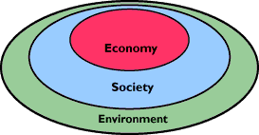
Three parts of sustainability:
Two Interpretations
From: http://www.sustainablemeasures.com

Slide 32
Carbon Reduction Solutions
Reducing CO₂ emissions benefits:
  The environment
  The economy
  Society
Practices that benefit all three of these
are said to be sustainable.

Slide 33

Carbon Reduction Solutions
Individual behaviors and consumer choices impact an individual’s carbon footprint.

Slide 34

One Strategy – Eat Local?
Is eating local always better?
New Zealand raised lamb
  Pasture-raised
  11,000 miles by boat to UK
  1,520 lbs CO₂/ton
UK raised lamb
  Conventionally grown, feed-reliant
  6,280 lbs CO₂/ton
From study conducted at Lincoln University in New Zealand

Slide 35
Food Miles versus Lifecycle Assessment
“Localism is not always the most environmentally sound solution if more emissions are generated at other stages of the product life cycle than during transport.”
  Landcare Research Manaaki Whenua, A New Zealand Environmental Research Organization

Slide 36





Activity 3: Hidden Energy
Everyday Items have Carbon Footprints

Slide 37
Hidden Energy:
Secondary Carbon Footprints
Observe the object in front of you.
Use the poster paper and markers provided to draw/diagram the materials used to make, market, utilize and dispose of this object.

Slide 38
Hidden Energy
Consider the following as you observe
this object:
  Raw materials
  Manufacturing
  Packaging, transport, and storage
  Marketing
  Use/Lifespan
  Disposal

Slide 39
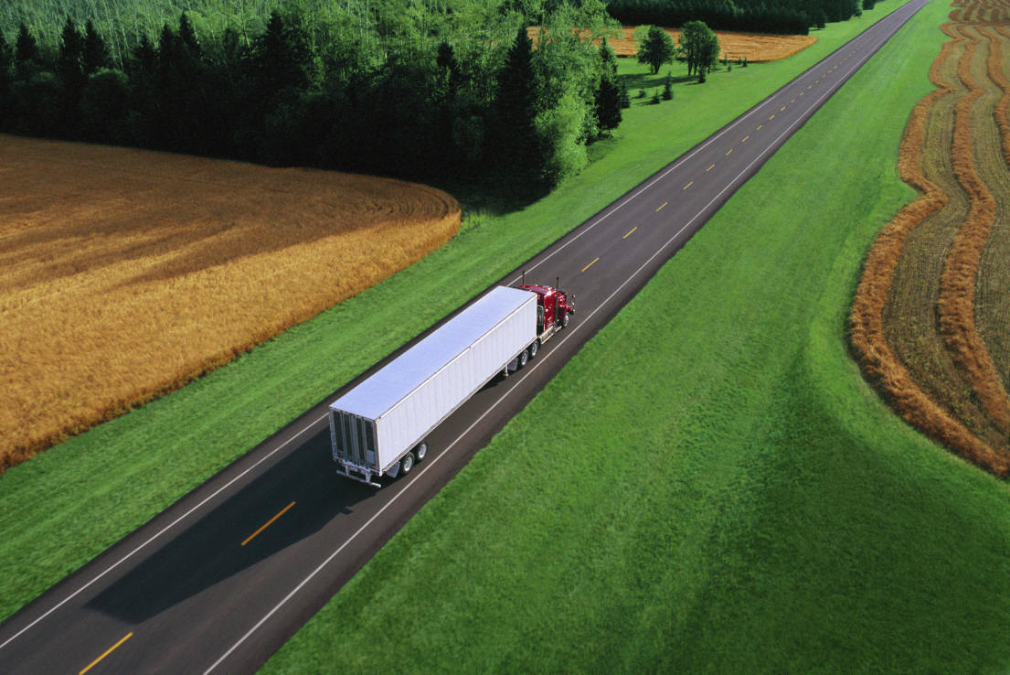
Hidden Energy
Finally, indicate the steps on your diagram that use energy and result in CO₂ emissions.

Slide 40
Hidden Energy
View your object from the perspective of the manufacturer: How can the carbon footprint of your object be reduced?
View your object from the perspective of the consumer: How can the carbon footprint of your object be reduced?

Slide 41
Hidden Energy In the News
“Wal-Mart asks Suppliers to Rate Energy Use”
The Wall Street Journal, September 24, 2007
25 – 30 companies that supply products such as DVDs, toothpaste, soap, milk, beer, vacuum cleaners, and soda will be asked to measure the amount of energy used to manufacture their products.
The company wants to cut packaging waste, increase fuel efficiency, and eventually operate entirely on renewable energy.

Slide 42
Hidden Energy
& The Informed Consumer
  Carbon Labeling
  Sustainability Ratings
  Eco-labels & Green Certification

Slide 43
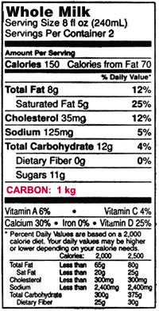

Carbon Labeling
Notes:
www.sightline.org/daily_score/archive/2007/01

Slide 44
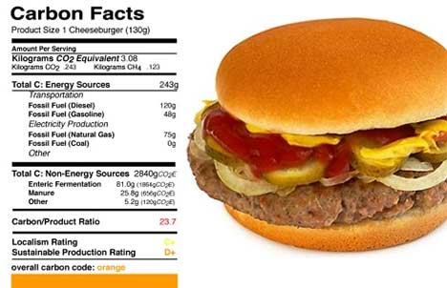
Sustainability Ratings
C+
D+
Notes:
www.sightline.org/daily_score/archive/2007/01
Mr. Cascio has since revisited his calculations and concluded that American cheeseburger consumption emits the greenhouse equivalent of "up to 13 million SUVs." C+

Slide 45
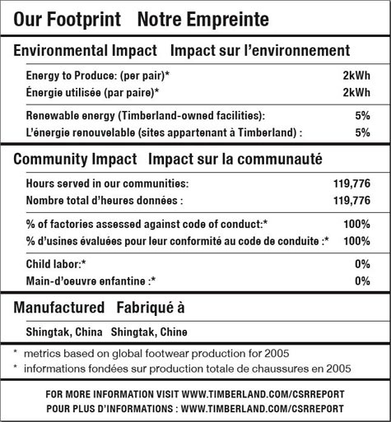


Eco-Labels & Green Certification

Slide 46
Carbon Reduction Solutions
Individual behaviors and consumer choices impact an individual’s carbon footprint.

Slide 47
Acknowledgements
ERP Staff
Christie Hinson, Civic Education Consortium, UNC
Terri Buckner, Office of Sustainability, UNC
Z. Smith Reynolds Foundation

Slide 48
Contact Information
Dana Haine, Science Educator
Environmental Resource Program,
UNC Institute for the Environment
dhaine@unc.edu
(919) 843-5735

